Slide 1
METHODS OF PERFORMANCE APPRAISAL
Dr. A. SELVARANI
Associate Professor
Jamal Institute of Management
Jamal Mohamed College

Slide 6
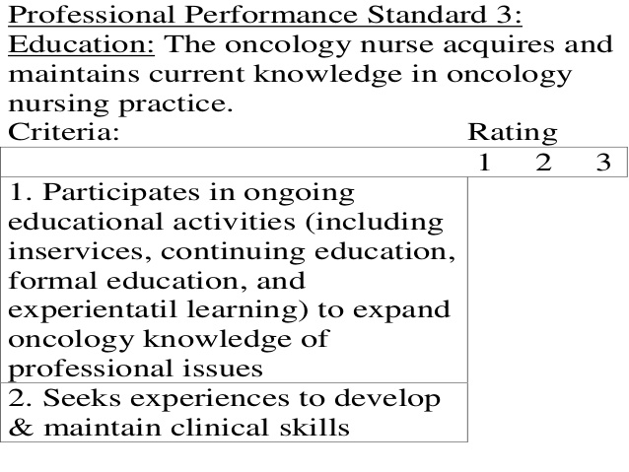

Slide 13
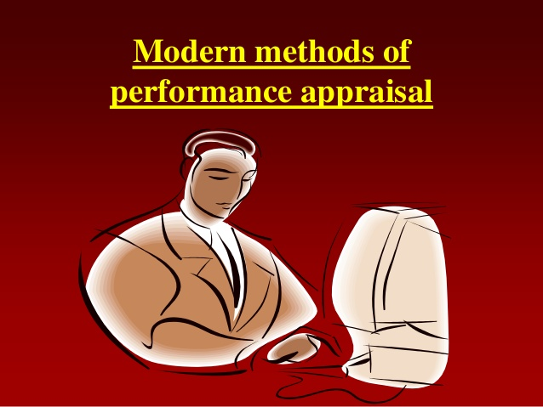

Slide 33
Behavior Observation Scale (BOS)
A performance appraisal that measures the frequency of observed behavior (critical incidents).
A behavior observation scale (BOS) is an appraisal method that measures behavior against levels of performance and also measures the frequency with which the behaviors occur. ... The question is typically related to the frequency or intensity of the symptom ofbehavior.

Slide 34
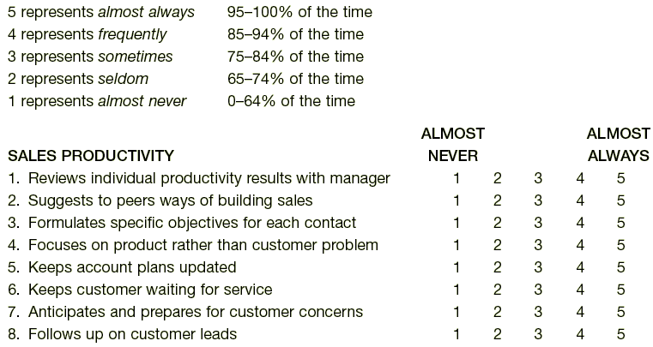
Behavior Observation Scales (BOS)

